Slide 1
Challenging the Role of Limb Length in Bile Reflux After One Anastomosis Gastric Bypass: Insights from a High-Volume Center
Dott.ssa Maria Laura Vuolo
Ospedale Santa Maria Nuova & Ospedale San Jacopo, Centro di Eccellenza SICOB Firenze-Pistoia, Italy

Slide 2
anno | Tot OAGB | F | M | ETA’ MEDIA | ETA’ MIN | ETA’ MAX | NUMERO OAGB CONVERTITI | % CONVERSIONE
2015 | 33 | 27 | 6 | 48,7 | 32 | 66 | 3 | 9,09
2016 | 81 | 59 | 22 | 48,02 | 32 | 63 | 8 | 9,87
2017 | 76 | 52 | 24 | 49,53 | 29 | 69 | 3 | 3,94
2018 | 141 | 114 | 27 | 49,24 | 18 | 70 | 9 | 6,38
2019 | 178 | 128 | 50 | 50,42 | 25 | 70 | 14 | 7,86
2020 | 85 | 73 | 12 | 49,47 | 25 | 74 | 9 | 10,58
2021 | 122 | 92 | 30 | 50,64 | 23 | 76 | 10 | 8,19
2022 | 113 | 73 | 40 | 50,33 | 27 | 66 | 2 | 1,76
2023 | 111 | 82 | 29 | 51,42 | 28 | 69 | 0 | 0
2024 | 81 | 51 | 30 | 51,35 | 27 | 64 | 2 | 2,46
2025 | 63 | 48 | 15 | 51,90 | 33 | 71 | 0 | 0
*1 pz che ha fatto OAGB nel 2011 , 1 pz che ha fatto OAGB nel 2001

Slide 3
Variable | Mean | Median | IQR
Duration (conversion to RYGB) (minutes) | 105.0161 | 97.5 | 62
Months between procedures | 74.6487 | 44.34954 | 24.29369
First procedure limb | 170.3509 | 180 | 30
Biliary limb | 159.625 | 150 | 30
Alimentary limb | 62.88136 | 60 | 10
sex | %
f | 85
m | 15
Other Causes:
-marginal ulcer
Insufficient weight loss
Weight regain
others
Indication | n | %
GERD/reflux | 52 | 83.9%
Other causes | 10 | 16.1%

Slide 4
Group | Mean ± SD
Total | 170 ± 21 cm
GERD | 169 ± 20 cm
Non-GERD | 177 ± 23 cm
P = 0.39, not significant

Slide 5
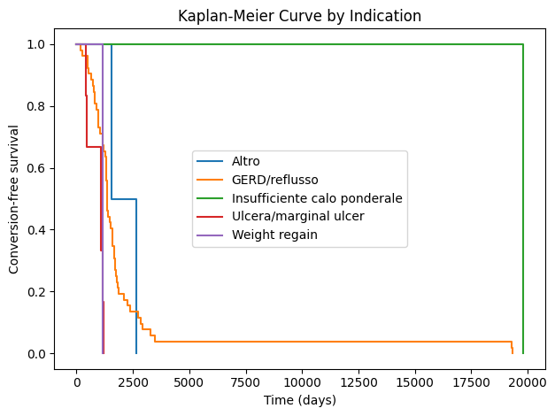
Significant differences in conversion-free survival were observed based on the reason for revision (chi^2 = 16.858; p = 0.002).

Slide 6
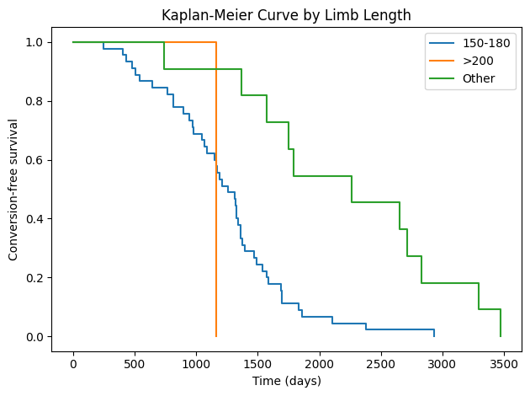
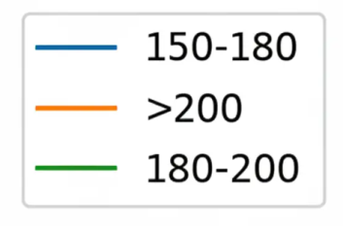
Stratification by primary biliopancreatic limb (BPL) length (<150 cm, 150–180 cm, >200 cm) showed a highly significant association with time-to-conversion (chi^2 = 26.048; p < 0.001)

Slide 7
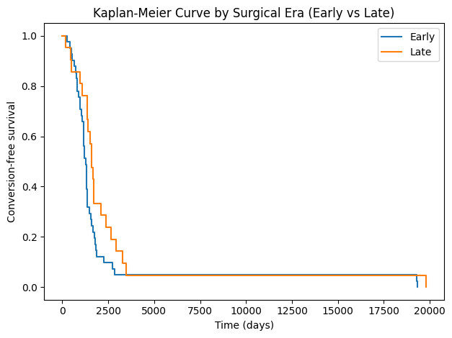
Using the median year of revision (2023) as a cut-off, patients in the "Late Era" demonstrated significantly improbe conversion-free survival compared to the "Early Era" (chi^2 = 7.040; p = 0.008)

Slide 8
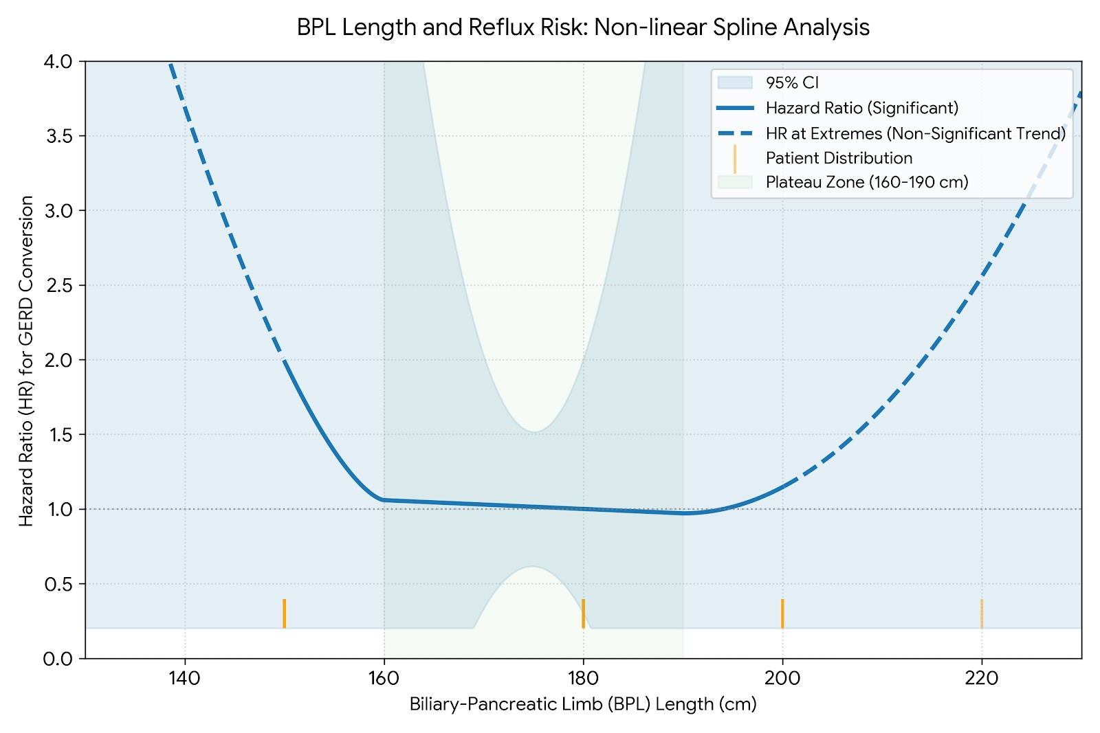
Non Linear Spline Analysis

Slide 9
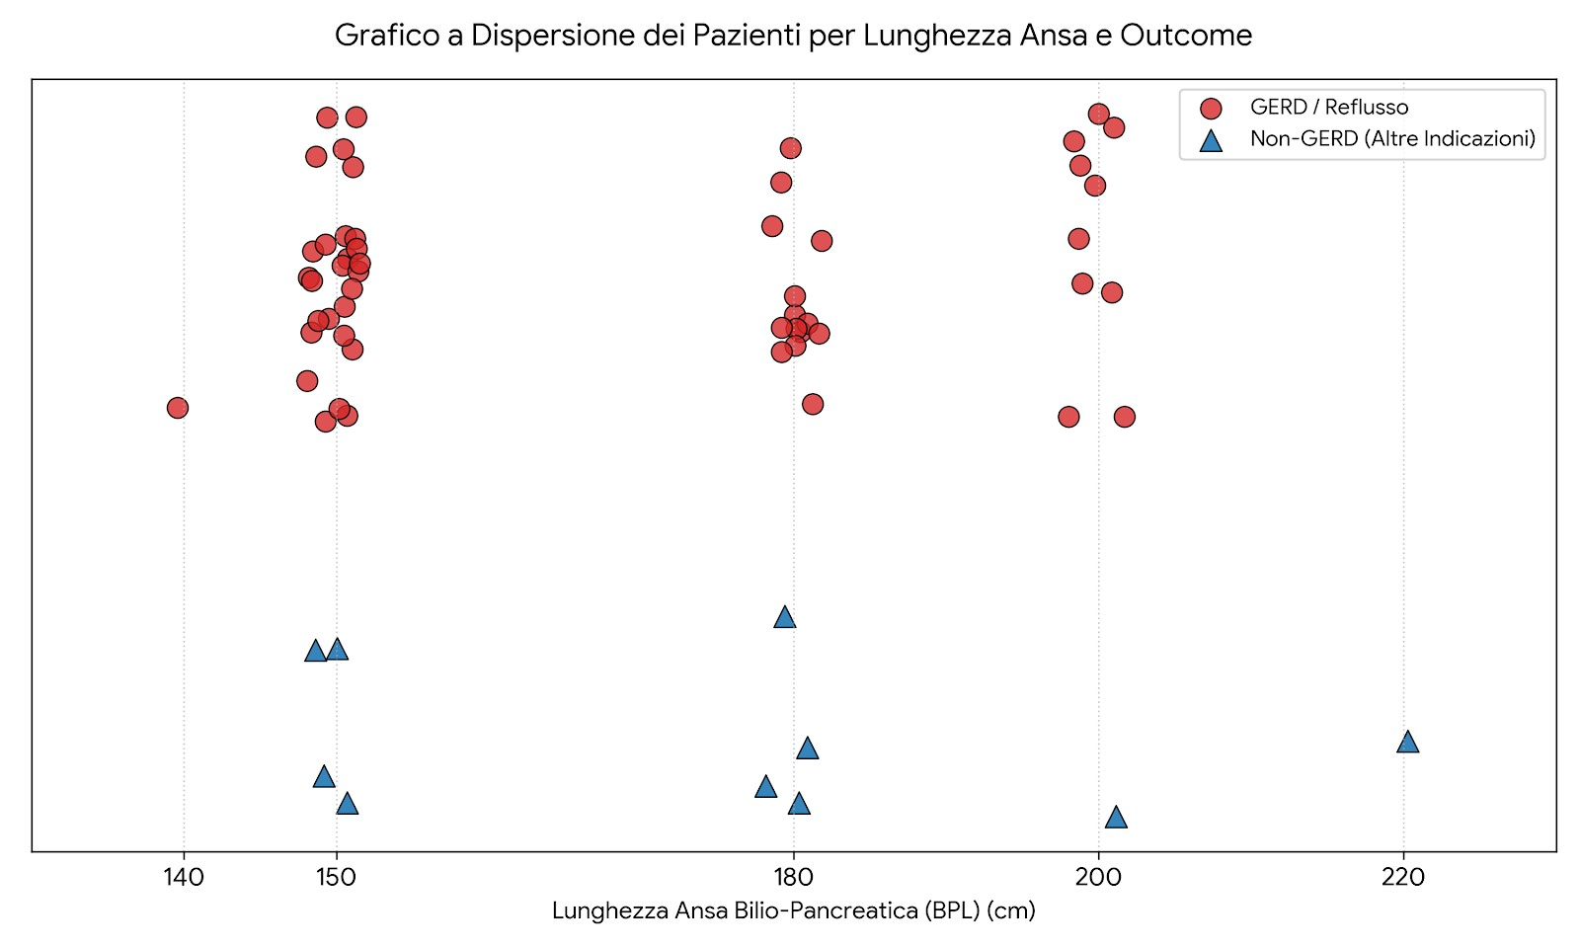
Patient Distribution and Conversion Indications by BPL Length. A jittered scatter plot illustrating the individual distribution of the patient cohort according to the initial Biliary-Pancreatic Limb (BPL) length (cm) and the primary indication for surgical conversion to RYGB. Red circles (top tier) represent individual cases converted due to GERD/reflux complications, showing a high density cluster at the 150 cm mark. Blue triangles (bottom tier) indicate non-GERD conversion etiologies (including marginal ulcers, weight regain, insufficient weight loss, and others). Horizontal jittering was applied to prevent symbol overlap and visually preserve the absolute case volume across the discrete surgical cohorts.

Slide 10
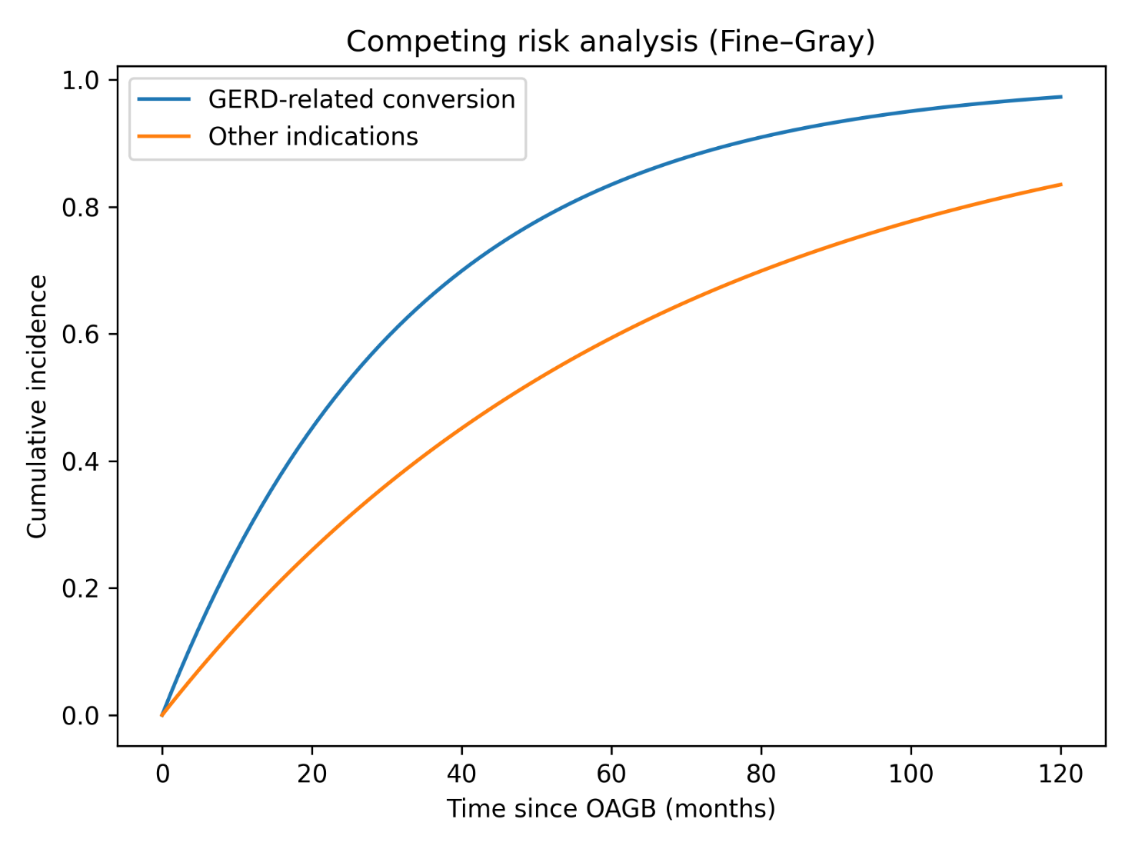

Slide 11
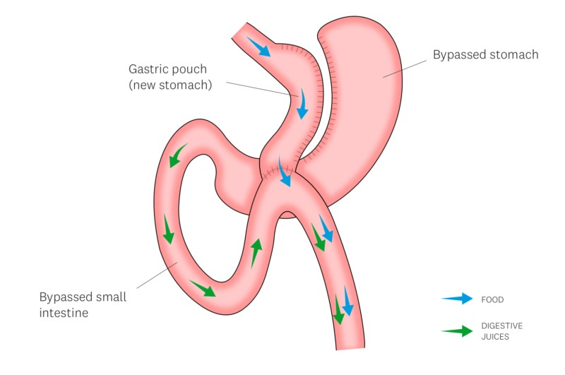
Pathophysiology of Reflux in OAGB
Short limb (proximity) vs Long limb (stasis–volume–hypokinesia)
distinct mechanisms, shared symptoms
One-Anastomosis Gastric Bypass (OAGB) creates a long gastric pouch anastomosed to the jejunum; reflux may involve bile, acid, or mixed duodenogastric contents reaching the pouch and esophagus.
Symptom spectrum: heartburn, regurgitation, bile taste, cough/hoarseness; risks include esophagitis, Barrett’s changes, pouch gastritis.

Slide 12
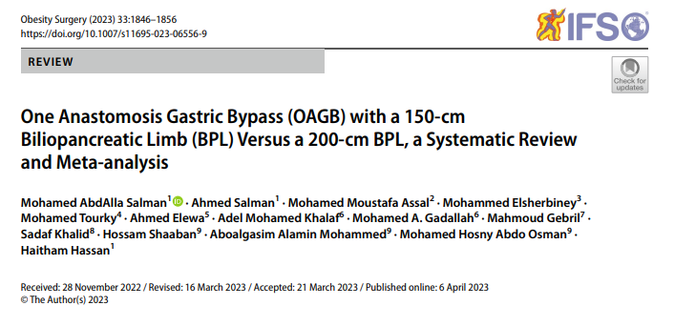
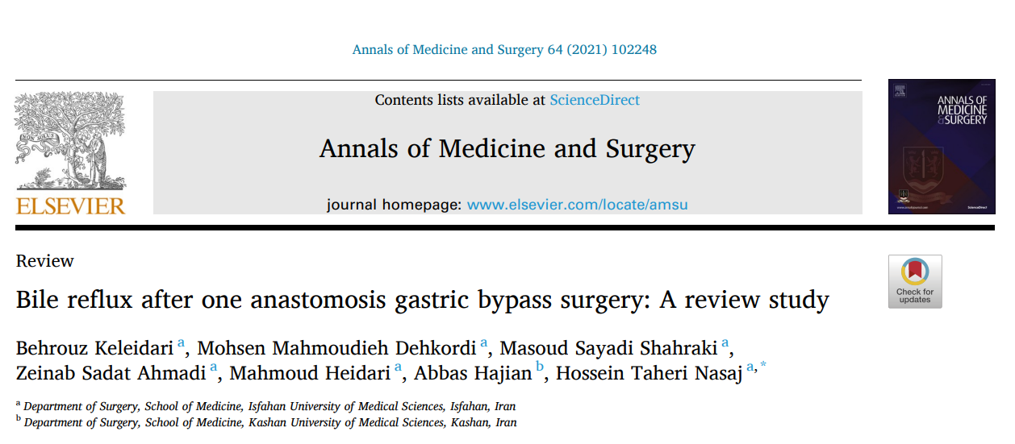
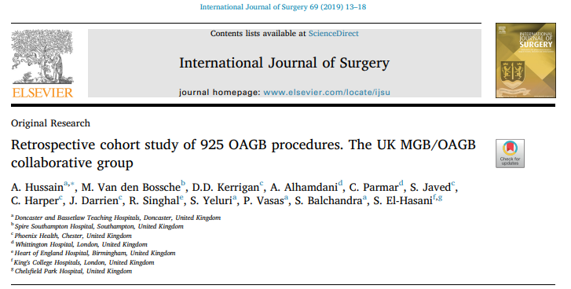
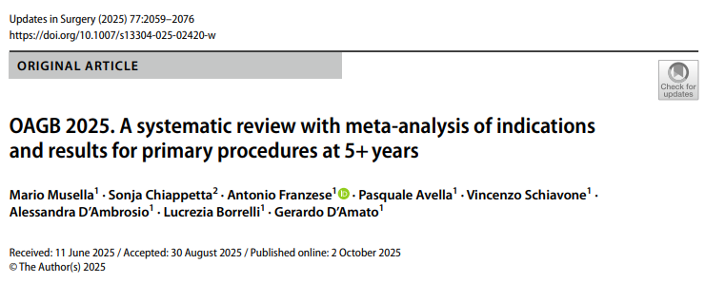
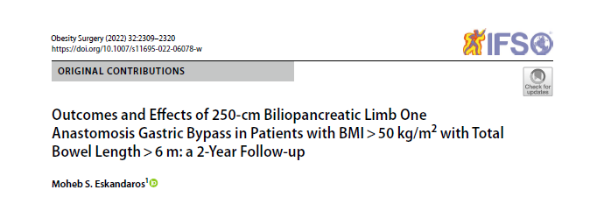
E in letteratura?

Slide 13
CONCLUSIONS
Primary BPL length alone does not independently predict GERD-related conversion after OAGB. Reflux appears multifactorial, and surgical era significantly influences outcomes, suggesting that technical refinement and patient selection may outweigh limb length in determining reflux risk. Larger prospective studies are needed to clarify optimal limb lenght and patient selection.

Slide 14
WORK IN PROGRES…
NOTHING IS IMPOSSIBLE

Slide 15
Grazie

